Slide 1
CoE Project Overview
Hitachi, Ltd.

Slide 2
Table of contents
１. What is CoE?
2. Our approach for CoE Project

Slide 3
1. What is CoE?
Notes:
V1からみて、何がうれしいか

Slide 4
CoE
Center of Excellence
Notes:
V1からみて、何がうれしいか

Slide 5
CoE
Center of Excellence
What is CoE in Nissan?
Notes:
V1からみて、何がうれしいか

Slide 6


Renault-Nissan Alliance Integration Project
Renault-Nissan Alliance Integration Project（from Jan, 2014）
Research/Development
Common Module Family development / Advanced Development /Power Train development /System Development / Integration of Research Center
Production Engineering
Logistics
Global Production Strategy, Production Execution Technology and SCM
Procurement
It has been more than 10 years since Common Procurement Organization was built. Will accelerate effectiveness of integration
Human Resource
Global talent management policy
Common human resource management process for alliance
IS/IT Contribution
Common IT/IS Solution for Alliance
Standardized solution will be applied to alliance with Common Framework

Slide 7
Renault-Nissan Alliance Integration Project
Renault-Nissan Alliance Integration Project（from Jan, 2014）
Research/Development
Common Module Family development / Advanced Development /Power Train development /System Development / Integration of Research Center
Production Engineering
Logistics
Global Production Strategy, Production Execution Technology and SCM
Procurement
It has been more than 10 years since Common Procurement Organization was built. Will accelerate effectiveness of integration
COE
Biz/IS will proceed these
Activities together as one “CoE” project,.
CoE is one of the integration Activities.
Human Resource
Global talent management policy
Common human resource management process for alliance
IS/IT Contribution
Common IT/IS Solution for Alliance
Standardized solution will be applied to alliance with Common Framework

Slide 8
Introduction (Background)
Quoted from Nissan’s doc
Alliance perspective
Manufacturing & SCM org. is defined as converged function.
There is discussion about alliance convergence in terms of system consolidation going on between Renault and Nissan Renault
Consolidation and/or replacement will be done when existing systems is facing EOS.
Nissan Global Perspective
Operation and systems are not standardized in some particular functional area such as manufacturing plan and shop floor control.
Operation and systems are also not standardized across regions and countries.
Nissan global standardization should be considered before going to Alliance standardization and/or consolidation.
Alliance and Nissan global system consolidation and/or optimization should be strongly considered and executed.

Slide 9
Convergence approach
Quoted from Nissan’s doc
Classical Approach
New Approach
Companies organized in silo
Knowledge not shared between companies or regions
Standard were designed by corp. team (far away from “gemba”) their process and IS were not suitable to local operational team
Companies will centralized knowledge and human resources (business/IS) of each region in one location
This organization will define what is "standard”
Human resources will return to their region, to do Copy & Paste of the standard definition establish with the others
Headquarter
STD
STD
STD
CoE
Nissan Biz
Nissan IS
Renault Biz
Renault IS

Slide 10
Current Status
Quoted from Nissan’s doc
A3 Plant study
Fit & Gap analysis EPIC (NMEX) versus iNIMS-PCS (NBA) revealed a big gap between Japan PC processes and emerging countries PC processes (India, Mexico, etc.)
How to ensure the support of all processes & design flexible and standard solutions ?
Outbound new contract in Brazil
New business scheme to be implemented in a very short term and no clear idea on a shelf of possible solution at alliance level to be implemented
How to support future contract negotiation for the Alliance in a short period ?
NIS-MES SFC renewal in Europe
Upgrade of shop floor control in Spain and UK required huge investment
Alliance PE VP wants to start alliance processes implementation in order to optimize IS/IT investment
How to minimize ISIT investment plan and maximize the re-use for the Alliance ?
From magical square…
…. to Center of Excellence
NML
Alliance and Global convergence study
Knowledge Center
Deployment planning
NE
Ren Biz
Nis Biz
NNA
COE
From all regions
With Biz and IS
To support performance
NML
NE
Nis IS
NNA
Ren IS

Slide 11
Vision & Mission
Quoted from Nissan’s doc
VISION
Deliver maximum business value and operation efficiency by providing standard solution through Center of Excellence
MISSION
Process harmonization: standardize process to reduce complexity
Knowledge center: Drive development of best practice
Support overall converging process to achieve business efficiency
WHY WE NEED
CoE
Develop future added value processes
Develop sustainable global knowledge center process and organization (skills and ability development)
Improve roll out methodology/activities to accelerate business and IS profitability

Slide 12


Activity Category in SCM/MES Domain
■ CoE Project Activity Category
Region
Europe
JP/Asia
America
Renault
PCS+M-BOM
MES+Quality Mgt
Outbound Logistics
Business Process Category
OTD（VOM/SIS）
Production Eng.
Packing Mgt

Slide 13
Activity Category in SCM/MES Domain
■ CoE Project Activity Category
Region
Europe
JP/Asia
America
Renault
PCS+M-BOM
IL&M
PCS
EPIC
GPI
MES+Quality Mgt
Outbound Logistics
Business Process Category
OTD（VOM/SIS）
Production Eng.
Packing Mgt

Slide 14
Activity Category in SCM/MES Domain
■ CoE Project Activity Category
Region
Europe
JP/Asia
America
Renault
PCS+M-BOM
IL&M
PCS
EPIC
GPI
MES+Quality Mgt
Will start from prod. control
Resources from each region or company has been transferred to Nissan in JP.
(Org. change)
Biz/IS has been proceeding PJ together.
Outbound Logistics
Business Process Category
COE
Biz
IS
Biz
IS
Biz
IS
OTD（VOM/SIS）
Japan
Production Eng.
Biz
IS
Packing Mgt
Asia

Slide 15
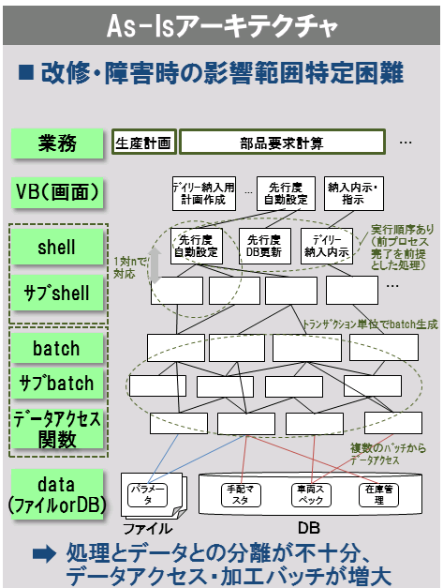
Activity Category in SCM/MES Domain
■ CoE Project Activity Category
Region
Europe
JP/Asia
America
Renault
PCS+M-BOM
IL&M
PCS
EPIC
GPI
MES+Quality Mgt
[Current PCS overview概要]
COBOL based system
Batch Oriented
3-4M Step
Screen：462
PG：3313
Report：369
Traditional Monolithic System
Outbound Logistics
Business Process Category
OTD（VOM/SIS）
Production Eng.
Packing Mgt

Slide 16
Activity Category in SCM/MES Domain
■ Milestone of CoE PCS
4 Phase
Current Phase : Planning
FY14 |  | FY15 |  | FY16 |  | FY17 |  | FY18～
Project Preparation/Organization Change
Preparation
Standard Business process design(Biz)
/System Development Planning/PoC
Planning
Dev/Testing
Implementation
Deployment to each factory
Deployment

Slide 17
Activity Category in SCM/MES Domain
■ Milestone of CoE PCS
4 Phase
Current Phase : Planning
FY14 |  | FY15 |  | FY16 |  | FY17 |  | FY18～
Project Preparation/Organization Change
Preparation
Standard Business process design(Biz)
/System Development Planning/PoC
Planning
Dev/Testing
Implementation
Hitchi has joined
This project
From Jun,2015
Deployment to each factory
Deployment

Slide 18
2. Our approach for CoE Project
Notes:
V1からみて、何がうれしいか

Slide 19
Our approach for CoE Project
■ Scope of Hitachi Activity
To achieve goal of CoE, a lot of tasks need to be taken care.
Alliance Mgt
Nissan、Renault、Daimler
Standardized Biz Process
SCM Best
Practice
Local business
Customs/
Region Specific
CoE
Mfg Technology
Design Technology
SCM
Knowledge
Of Legacy System
/IF system
System
Architecture

Slide 20

Our approach for CoE Project
■ Scope of Hitachi Activity
To achieve goal of CoE, a lot of tasks need to be taken care.
Alliance Mgt
Nissan、Renault、Daimler
Standardized Biz Process
SCM Best
Practice
Local business
Customs/
Region Specific
CoE
Mfg Technology
Design Technology
SCM
Knowledge
Of Legacy System
/IF system
System
Architecture
Our Scope

Slide 21
Our approach for CoE Project
■ Scope of Hitachi Activity
Hitachi has been take care of PoC in FY2016
2016年度支援内容
2016年度活動内容
連携先
Design of Next System Architecture
Proof of Concept
For New Arch.
Hitachi, LTD
Jo-En
&
Yokohama
Research Center
System
Architecture
Analysis of Current
PCS with AMO knowledge
Reverse Engineering and
Implementation
With New Archj
HS21
NCS
Knowledge
Of Legacy System
/IF system

Slide 22
Our approach for CoE Project
FY14 |  | FY15 |  | FY16 |  | FY17 |  | FY18～
Preparation
Planning
Implementation
Deployment
 | FY2016/1Q |  | FY2016/2Q |  |  | FY2016/3Q |  |  | FY2016/4Q |  |  | FY 2016－
 | 5 | 6 | 7 | 8 | 9 | 10 | 11 | 12 | 1 | 2 | 3
Activity
System
Architecture
New Architecture PoC
Dev.
Knowledge
Of Legacy
/IF system
Reverse Engineering
Trial

Slide 23
Our approach for CoE Project
FY14 |  | FY15 |  | FY16 |  | FY17 |  | FY18～
Preparation
Planning
Implementation
Deployment
 | FY2016/1Q |  | FY2016/2Q |  |  | FY2016/3Q |  |  | FY2016/4Q |  |  | FY 2016－
 | 5 | 6 | 7 | 8 | 9 | 10 | 11 | 12 | 1 | 2 | 3
Activity
System
Architecture
New Architecture PoC
Dev.
Knowledge
Of Legacy
/IF system
Reverse Engineering
Trial

Slide 24
Our approach for CoE Project
System
Architecture
■ What is requirement for new architecture
Simple
Stable
Flexible

Slide 25
・New UI
・Feature Flag
・Infrastructure as Code
・Automation
(Test/Build/Deploy)
Our approach for CoE Project
System
Architecture
■ What is requirement for new architecture
Simple
Simple to use for User
Simple to maintain for SI
Consist of universal technology
which is available anywhere
Simple
・Microservice
・REST I/F
・Release Management
・API Management
・Infrastructure as Code
・Cloud
・Docker
・Agile
・Microservice
・REST I/F
・Release Management
・Feature Flag
・Infrastructure as Code
・Automation
(Test/Build/Deploy)
Stable
Flexible
Stable
Minimize service
outage
Flexible
Can respond to
requirement change
flexibly.

Slide 26
Our approach for CoE Project
System
Architecture
Requirement
As-Iｓ System(monolith)
Flexible
Flexible to change function or data
Easy to change biz process flow
Tightly coupled System
UI
Process
Data
Stable
Minimize service outage.
Deploy new or Modified function without outage.
It is difficult to identify
impact of system
failure due to tightly
coupled system.
Service outage required to deploy
Simple
High usability UI
Universal technology which is available anywhere
Low usability (VB)
Vendor dependent
Technology.

Slide 27
Our approach for CoE Project
System
Architecture
Requirement
As-Iｓ System(monolith)
To-Be System
Flexible
Flexible to change function or data
Easy to change biz process flow
Tightly coupled System
A: Loosely coupled
Elements of system are
Separated and loosely
coupled
UI
Process
High usability
(JS)
Data
UI
Stable
Minimize service outage.
Deploy new or Modified function without outage.
It is difficult to identify
impact of system
failure due to tightly
coupled system.
Service outage required to deploy
REST I/F
Process
Simple
High usability UI
Universal technology which is available anywhere
Low usability (VB)
Vendor dependent
Technology.
Data
B.OSS(DevOps)
－DE fact Standard OSS

Slide 28
Our approach for CoE Project
System
Architecture
Requirement
As-Iｓ System(monolith)
To-Be System
Flexible
Flexible to change function or data
Easy to change biz process flow
Tightly coupled System
A: Loosely coupled
Elements of system are
Separated and loosely
coupled
UI
Process
High usability
(JS)
Data
UI
Stable
Minimize service outage.
Deploy new or Modified function without outage.
It is difficult to identify
impact of system
failure due to tightly
coupled system.
Service outage required to deploy
REST I/F
Process
Simple
High usability UI
Universal technology which is available anywhere
Low usability (VB)
Vendor dependent
Technology.
Data
B.OSS(DevOps)
－DE fact Standard OSS

Slide 29
Conceptual Architecture Diagram
System
Architecture
■ Loosely Coupled Architecture
Connected with
REST I/F(HTTP+JSON)
Screen
Other
System
Other
Service
…
Presentation
REST IF
Micro Service
HTTP + JSON
Security Framework
Access Control
Logic
Task
Task
Dependency is Managed
By Batch Framework。
Framework
(Spring Batch)
…
Java
Java
REST IF
HTTP + JSON or JPA
Data access with
JPA or REST I/F(HTTP+JSON)
Data
Framework
(Spring Data)
RDB
No SQL
File

Slide 30
Conceptual Architecture Diagram
System
Architecture
Business Process Flow(JSON)
Operation
(UI/Scheduler/IF)
JOB(XML)
Task(CLASS)
Task(CLASS)
Rule(METHOD)
Rule(METHOD)
Input
Output
Parameter

Slide 31
Conceptual Architecture Diagram
System
Architecture
Business Process Flow(JSON)
Business Process
Operation
(UI/Scheduler/IF)
Operation / Initiation
JOB(XML)
Service
Task(CLASS)
Task(CLASS)
Rule(METHOD)
Rule(METHOD)
Input
Output
Parameter

Slide 32
Conceptual Architecture Diagram
System
Architecture
Business Process Flow(JSON)
Business Process
Operation
(UI/Scheduler/IF)
Operation / Initiation
JOB(XML)
Service
Task(CLASS)
Task(CLASS)
Task(Re-usable)
Rule(METHOD)
Rule(METHOD)
Input
Output
Parameter

Slide 33
Conceptual Architecture Diagram
System
Architecture
Business Process Flow(JSON)
Business Process
Operation
(UI/Scheduler/IF)
Operation / Initiation
JOB(XML)
Service
Task(CLASS)
Task(CLASS)
Task(Re-usable)
Rule(METHOD)
Rule
Rule(METHOD)
Input
Output
Input data
/Output data
Parameter
Parameter

Slide 34
Our approach for CoE Project
System
Architecture
Requirement
As-Iｓ System(monolith)
To-Be System
Flexible
Flexible to change function or data
Easy to change biz process flow
Tightly coupled System
A: Loosely coupled
Elements of system are
Separated and loosely
coupled
UI
Process
High usability
(JS)
Data
UI
Stable
Minimize service outage.
Deploy new or Modified function without outage.
It is difficult to identify
impact of system
failure due to tightly
coupled system.
Service outage required to deploy
REST I/F
Process
Simple
High usability UI
Universal technology which is available anywhere
Low usability (VB)
Vendor dependent
Technology.
Data
B.OSS(DevOps)
－DE fact Standard OSS

Slide 35














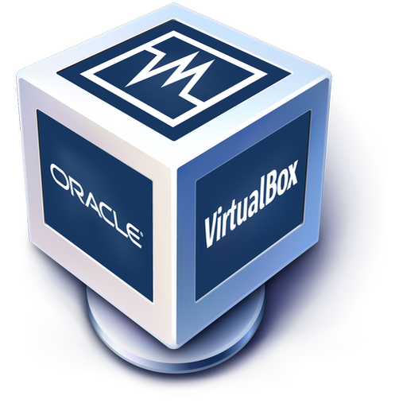



CI Flow
System
Architecture
Design/Dev
Test
Release
Out of
Scope
Cobertura
Application FW
Repository Mgt
Build Tool
Inspection
Test FW
UI Auto Testing
Check
Out
Build Exec.
Inspection Exec.
Test Exec.
UI Test Exec.
Results
GitLab CI
Lombok
CI Mgt
Results
JAVA Library
Hook
Results
DBMS
Hook
Ticket Based PJ Mgt
Dev. Env.
Test. Env.
仮想化
環境構築自動化
コンテナ仮想

Slide 36
Our approach for CoE Project
FY14 |  | FY15 |  | FY16 |  | FY17 |  | FY18～
Preparation
Planning
Implementation
Deployment
 | FY2016/1Q |  | FY2016/2Q |  |  | FY2016/3Q |  |  | FY2016/4Q |  |  | FY 2016－
 | 5 | 6 | 7 | 8 | 9 | 10 | 11 | 12 | 1 | 2 | 3
Activity
System
Architecture
New Architecture PoC
Dev.
Knowledge
Of Legacy
/IF system
Reverse Engineering
Trial

Slide 37
Reverse Engineering Trial
Knowledge
Of Legacy
/IF system
As Is PCS functionalities are implemented with new CoE Framework to make sure
feasibility of new architecture
PCS
CoE
Reverse
Engineering

Slide 38
Reverse Engineering Trial
Knowledge
Of Legacy
/IF system
Basic concept of Reverse Engineering is as follows.
PCS
CoE
UI
(VB)
UI
(JS/JAVA)
Job/Stream
Job(XML)
Shell
MPP
(VB/COBOL
/C)
Batch
(COBOL)
Task
(JAVA)
Repository
(JAVA)
DB
DB
(DOMAIN/JAVA)

Slide 39
Reverse Engineering Trial
Knowledge
Of Legacy
/IF system
The below steps will be followed to achieve high quality and efficiency.
Most important step is Analysis/Extracting and Semi-Automatic generation of code.
Reverse Engineering Flow
Analysis/
Extracting
Semi-Automatic
Semi-Automatic
PCS
Specification
Documents
CoE
Logic/Spec
Manual Dev.
Business logic needs to be developed manually.

Slide 40
Reverse Engineering Trial
Knowledge
Of Legacy
/IF system
Reverse Engineering Flow
Analysis/
Extracting
Semi-Automatic
Semi-Automatic
PCS
Specification
Documents
CoE
Logic/Spec
Manual Dev.
Business logic needs to be developed manually.
Clarification of
Total amount
Structural
Analysis
Syntactic
Analysis
- Clarify what is goal and target.
-Progress check
-Attribute Clarification
(Difficulty of Logic etc)
-Implementation is required or not
-Automatic Generation is available or not
-Extract logic/Spec
-Automatic Generation of JAVA source
(in case Auto Generation is available)

Slide 41
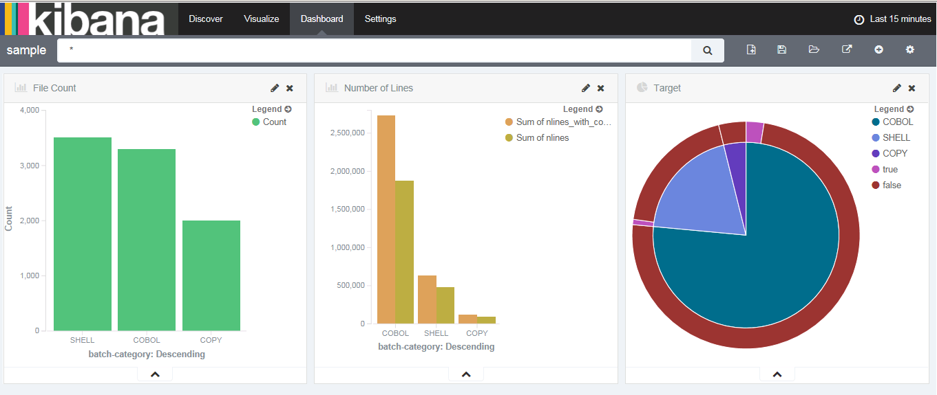
Reverse Engineering Trial
Knowledge
Of Legacy
/IF system
Clarification of
Total amount
Structural
Analysis
Syntactic
Analysis
Sample of amount confirmation
Total amount of files
Target of R. E.

Slide 42
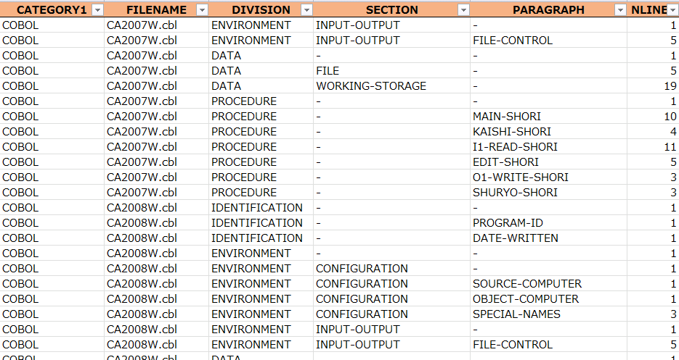
Reverse Engineering Trial
Knowledge
Of Legacy
/IF system
Clarification of
Total amount
Structural
Analysis
Syntactic
Analysis
Sample of Cobol paragraph Analysis

Slide 43
Reverse Engineering Trial
Knowledge
Of Legacy
/IF system
Reverse Engineering Flow
Analysis/
Extracting
Semi-Automatic
Semi-Automatic
PCS
Specification
Documents
CoE
Logic/Spec
Manual Dev.
Business logic needs to be developed manually.

Slide 44
Reverse Engineering Trial
Knowledge
Of Legacy
/IF system
PCS
CoE PCS
Biz Proc Flow
(JSON)
UI
(VB)
UI
(JS/JAVA)
Job/Stream
Job(XML)
Shell
Task
(CLASS)
MPP
(VB/COBOL
/C)
Batch
(COBOL)
Rule
(METHOD)
Repository/Domain
(JAVA)
DB
DB

Slide 45
Reverse Engineering Trial
Knowledge
Of Legacy
/IF system
PCS
Automatic Generation Template
CoE PCS
Manual
Automatic
Excel
JAVA
XML
Biz Proc Flow
(JSON)
UI
(VB)
UI
(JS/JAVA)
Job/Stream
Input element info
SCHEDULE
LIST
Job(XML)
JOB.XML
Shell
LAUNCHER
Task
(CLASS)
MPP
(VB/COBOL
/C)
Batch
(COBOL)
Input element info
JOB_LIST
TASK_LIST
RULE_LIST
TASK BASE
Rule
(METHOD)
TASK
Business logic needs to be implemented
REPOSITORY
BASE
Input element info
Repository/Domain
(JAVA)
DB
(Create table)
*No stored Procedure
TABLE_LIST
COLUMN
LIST
REPOSITORY
DB
DOMAIN

Slide 46
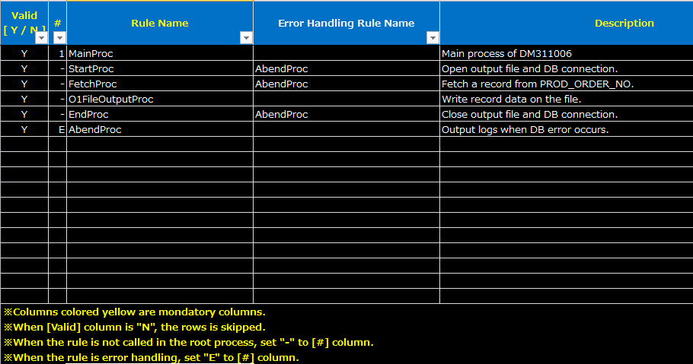
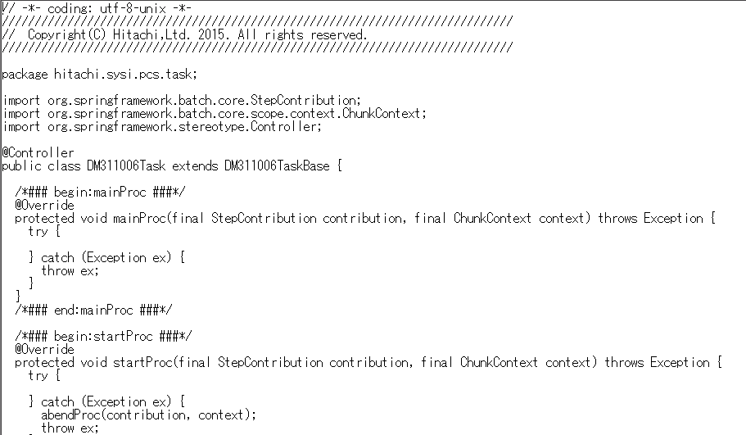
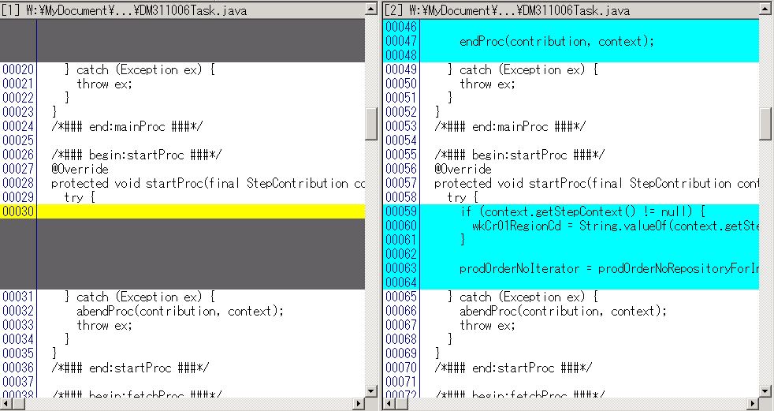
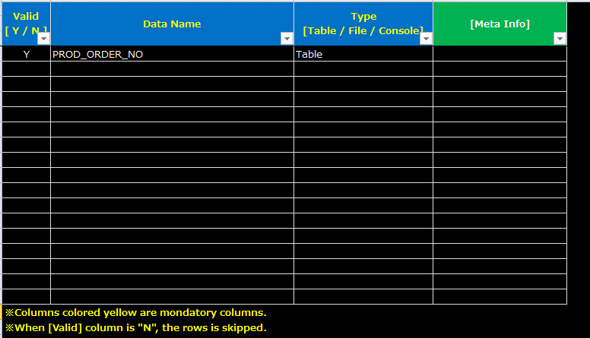
Reverse Engineering Trial
Knowledge
Of Legacy
/IF system
Example of “Task” implementation
TASK_LIST
TASK
TASK
Business Logic
Put task name in the Task List(excel).
Ex. task_definition_DM311006.xlsx
-Execute auto generation script to generate source code.
-Frame of logic(Java) is automatically generated.
Ex.
DM311006TaskBase.java
DM311006Task.java
-Write business logic in generated source code
Ex.
DM311006Task.java

